Slide 1
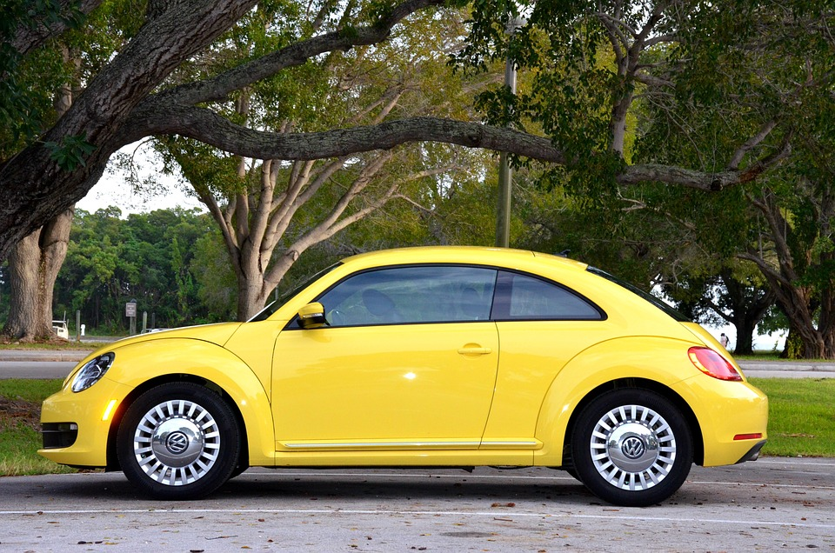
Analyzing the Impact of Car Features on Price and Profitability
BY-ANAMIKA

Slide 2
PROJECT DESCRIPTION
The automotive industry has been rapidly evolving over the past few decades with a growing focus on fuel efficiency, environmental sustainability, and technology innovation. With increasing competition in the market, manufacturers want to change the consumer landscape.
This project objective is to analyze the car features that affect the manufacturers’ car prices. As a Data Analyst, the client has asked how can a car manufacturer optimize pricing and product development decisions to maximize profitability while meeting consumer demand.
Dataset contains information on various car models and their applications.
Total number of observations:- 11,159
File type:- CSV

Slide 3
TECH STACK USED
Microsoft Excel
All the analysis has been performed in excel. This tool is also used to create graphical representation of the results and to understand the result set better.

Slide 4
APPROACH
For analysis I used descriptive statistics, regression analysis, and visualization to visualize the charts and graphs.
The reason behind using descriptive analysis was to find out the mean of the car’s features variable and then visualize them in the form of charts and graphs.
Regression Analysis told the dependency of independent variables to dependent variables i.e., the specific features of the car impact the car’s price
While creating the charts it was difficult to summarize the values of variables in sum or average.

Slide 5
PROJECT INSIGHT

Slide 6
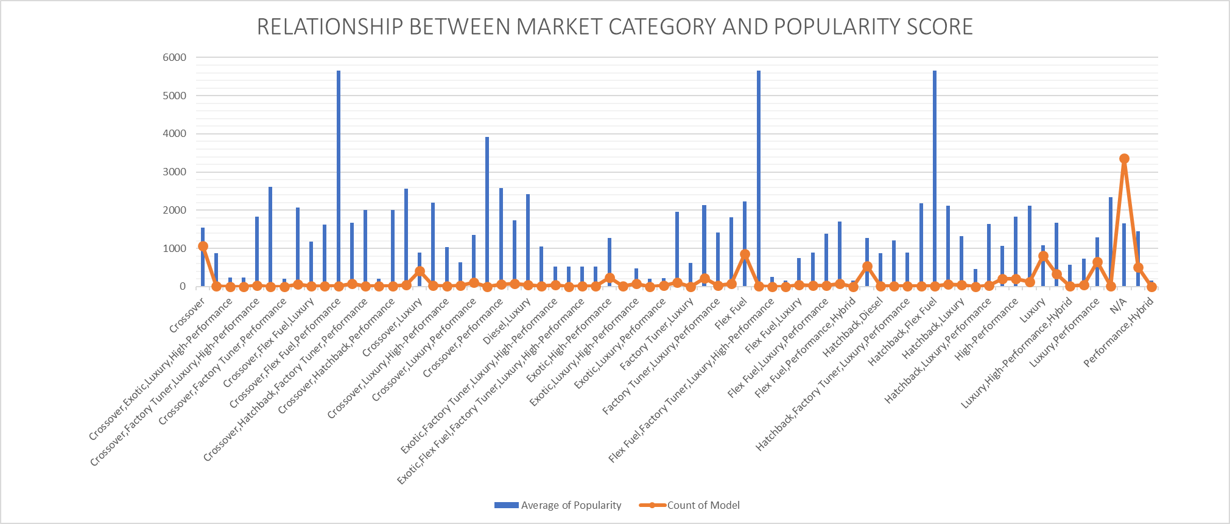
Insight Required: How does the popularity of a car model vary across different market categories? Task 1.A: Create a pivot table that shows the number of car models in each market category and their corresponding popularity scores. Task 1.B: Create a combo chart that visualizes the relationship between market category and popularity.
From the line chart, we can see that Hatchback & Flex Fuel are the highest populated and have the highest number of cars.

Slide 7
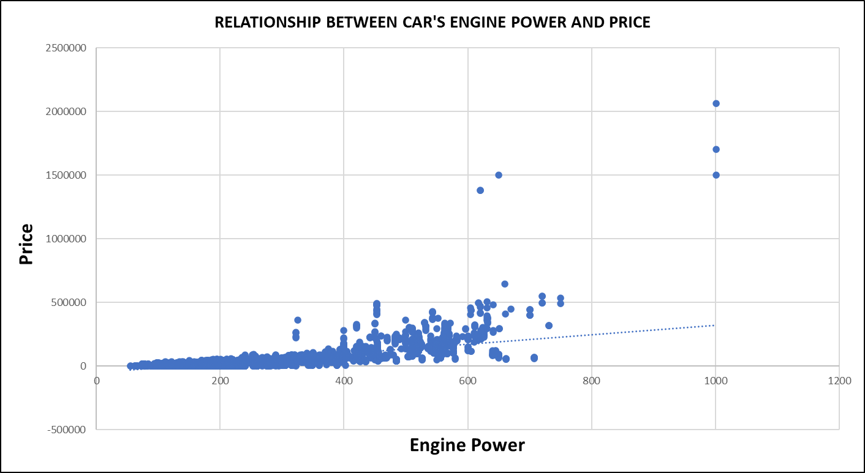
Insight Required: What is the relationship between a car's engine power and its price? Task 2: Create a scatter chart that plots engine power on the x-axis and price on the y-axis. Add a trendline to the chart to visualize the relationship between these variables.
From the scatter plot, we can observe that cars that have high engine power have higher prices. Thus, the car’s power increases as the car’s price will also increase.

Slide 8
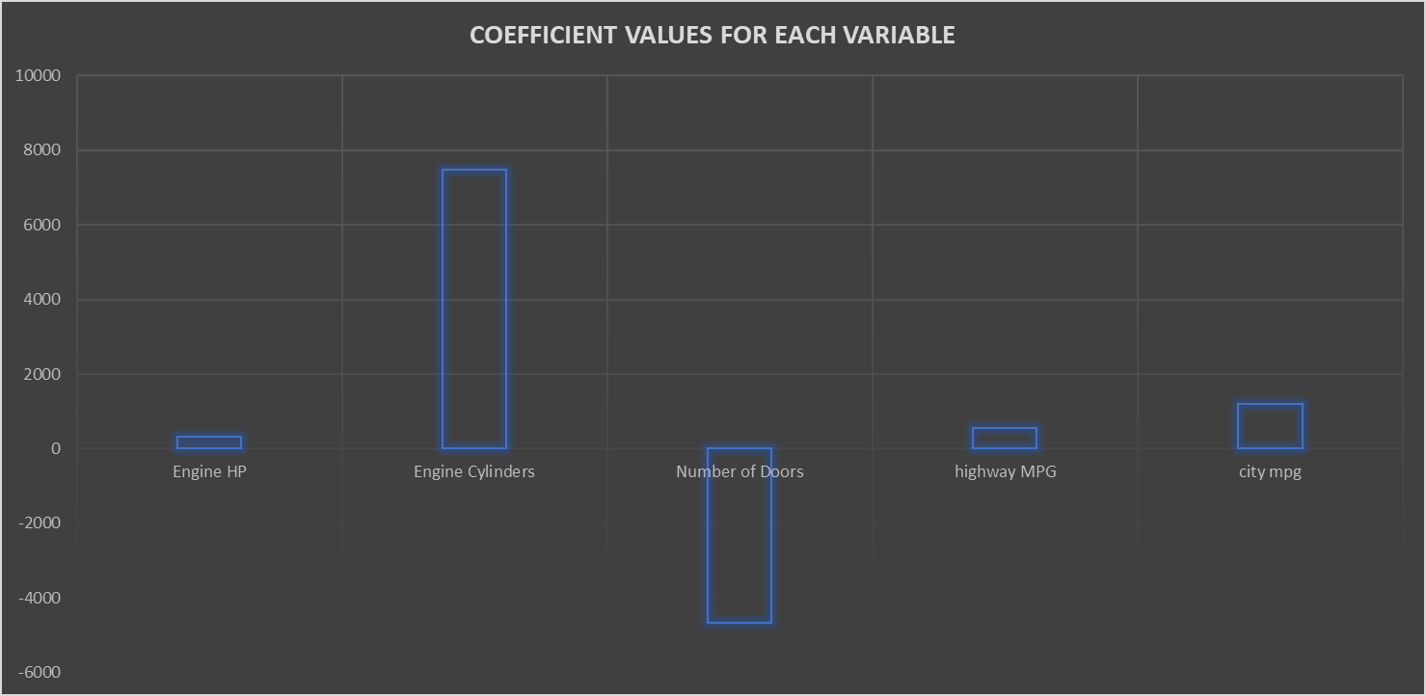
Insight Required: Which car features are most important in determining a car's price?
Task 3: Use regression analysis to identify the variables that have the strongest relationship with a car's price. Then create a bar chart that shows the coefficient values for each variable to visualize their relative importance.
From the bar chart, we can see that Engine Cylinders have the strongest relationship with MSRP

Slide 9
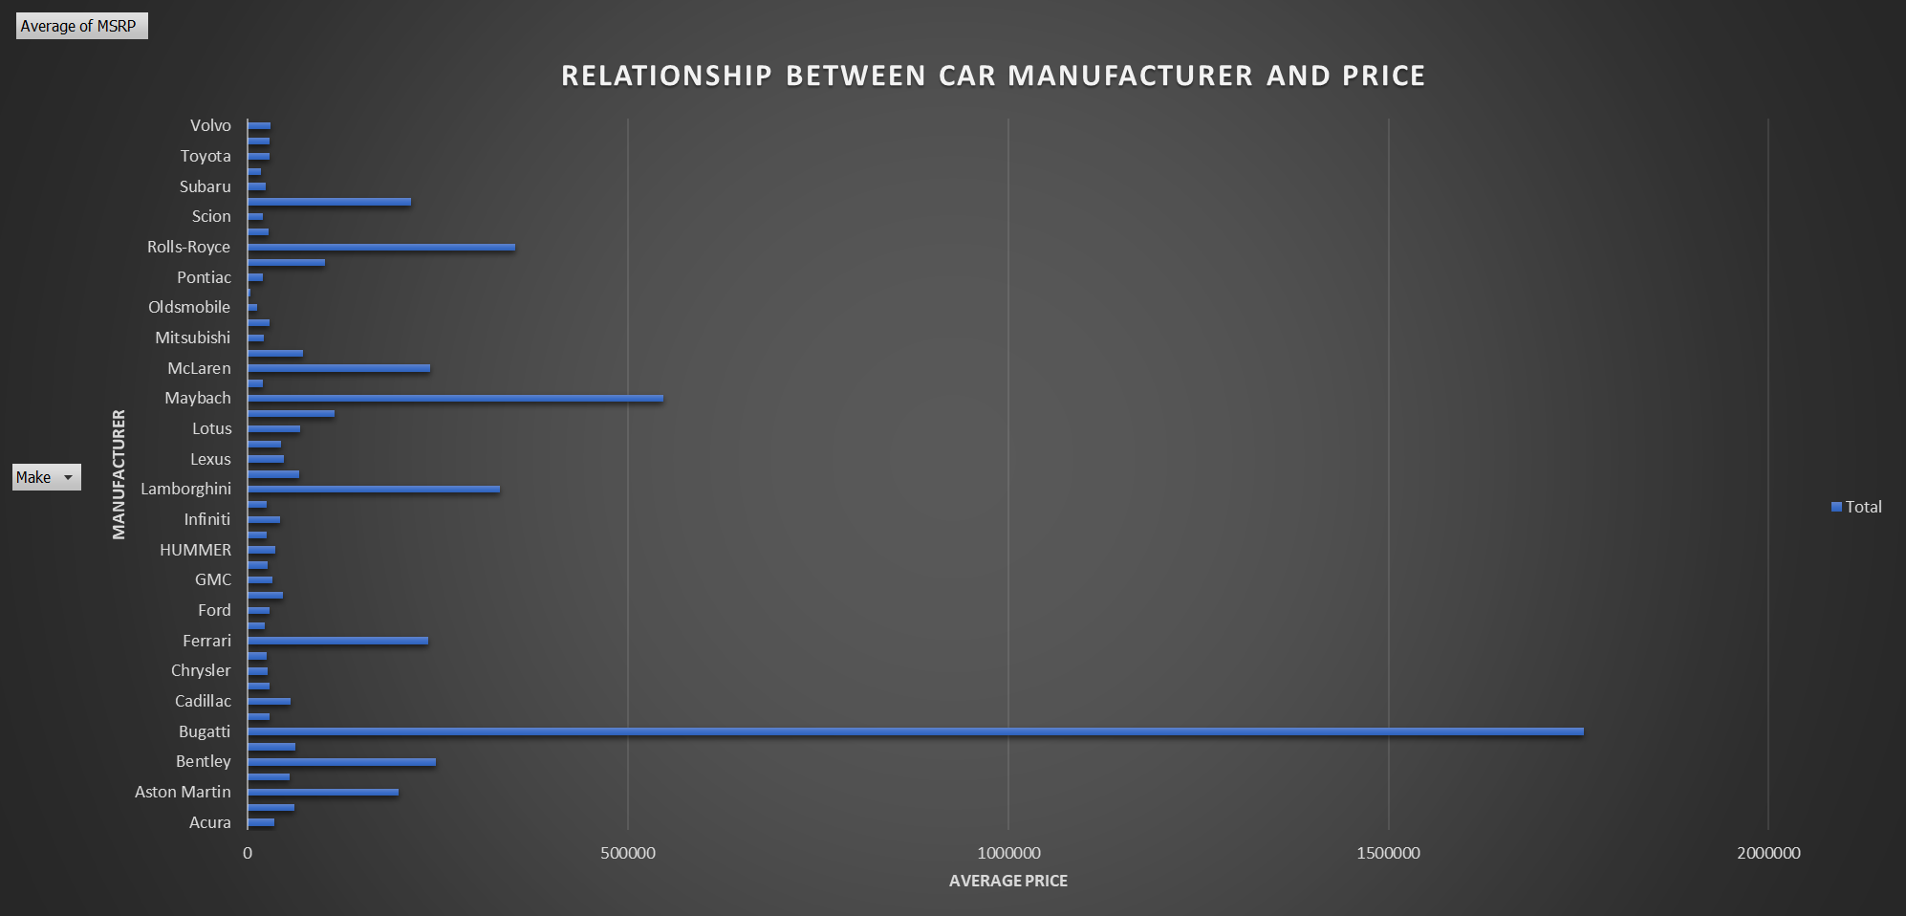
Insight Required: How does the average price of a car vary across different manufacturers? Task 4.A: Create a pivot table that shows the average price of cars for each manufacturer. Task 4.B: Create a bar chart or a horizontal stacked bar chart that visualizes the relationship between manufacturer and average price.
From the bar chart, we can say that Bugatti has the highest average price

Slide 10
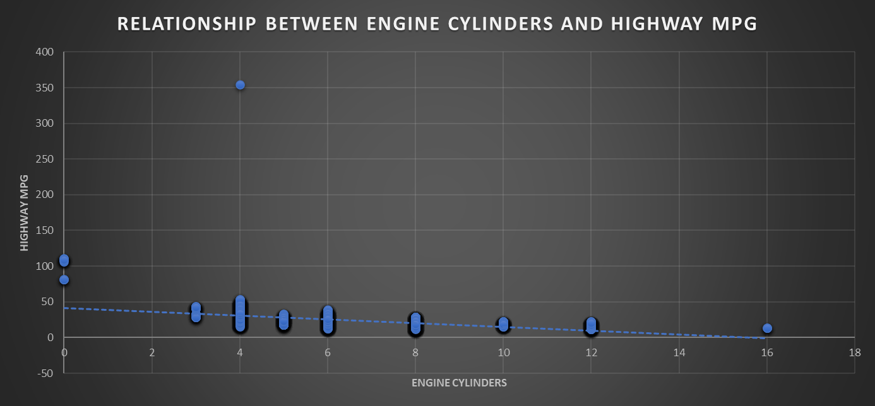
Insight Required: What is the relationship between fuel efficiency and the number of cylinders in a car's engine? Task 5.A: Create a scatter plot with the number of cylinders on the x-axis and highway MPG on the y-axis. Then create a trendline on the scatter plot to visually estimate the slope of the relationship and assess its significance. Task 5.B: Calculate the correlation coefficient between the number of cylinders and highway MPG to quantify the strength and direction of the relationship.
From the chart, we can see that cylinders having 4 is giving maximum fuel efficiency.
And Fuel efficiency is inversely proportional to the no. of cylinders

Slide 11
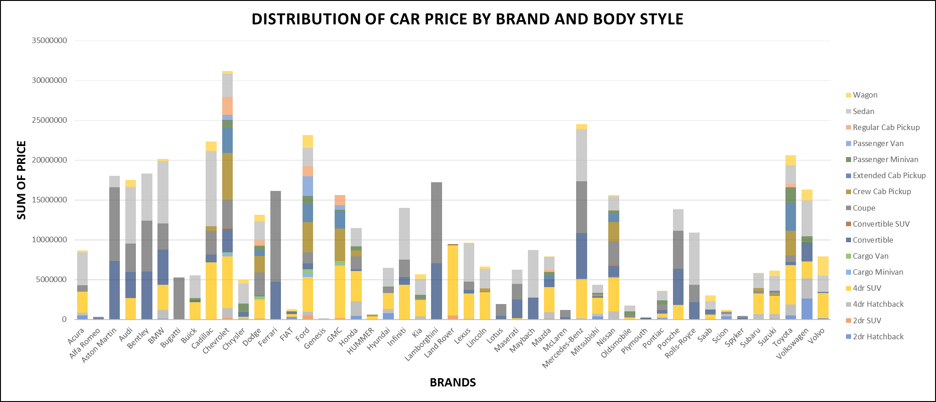
Building the Dashboard:
Task 1: How does the distribution of car prices vary by brand and body style?
From the stacked column, Chevrolet and Mercedes-Benz have the highest contribution to the car’s price

Slide 12
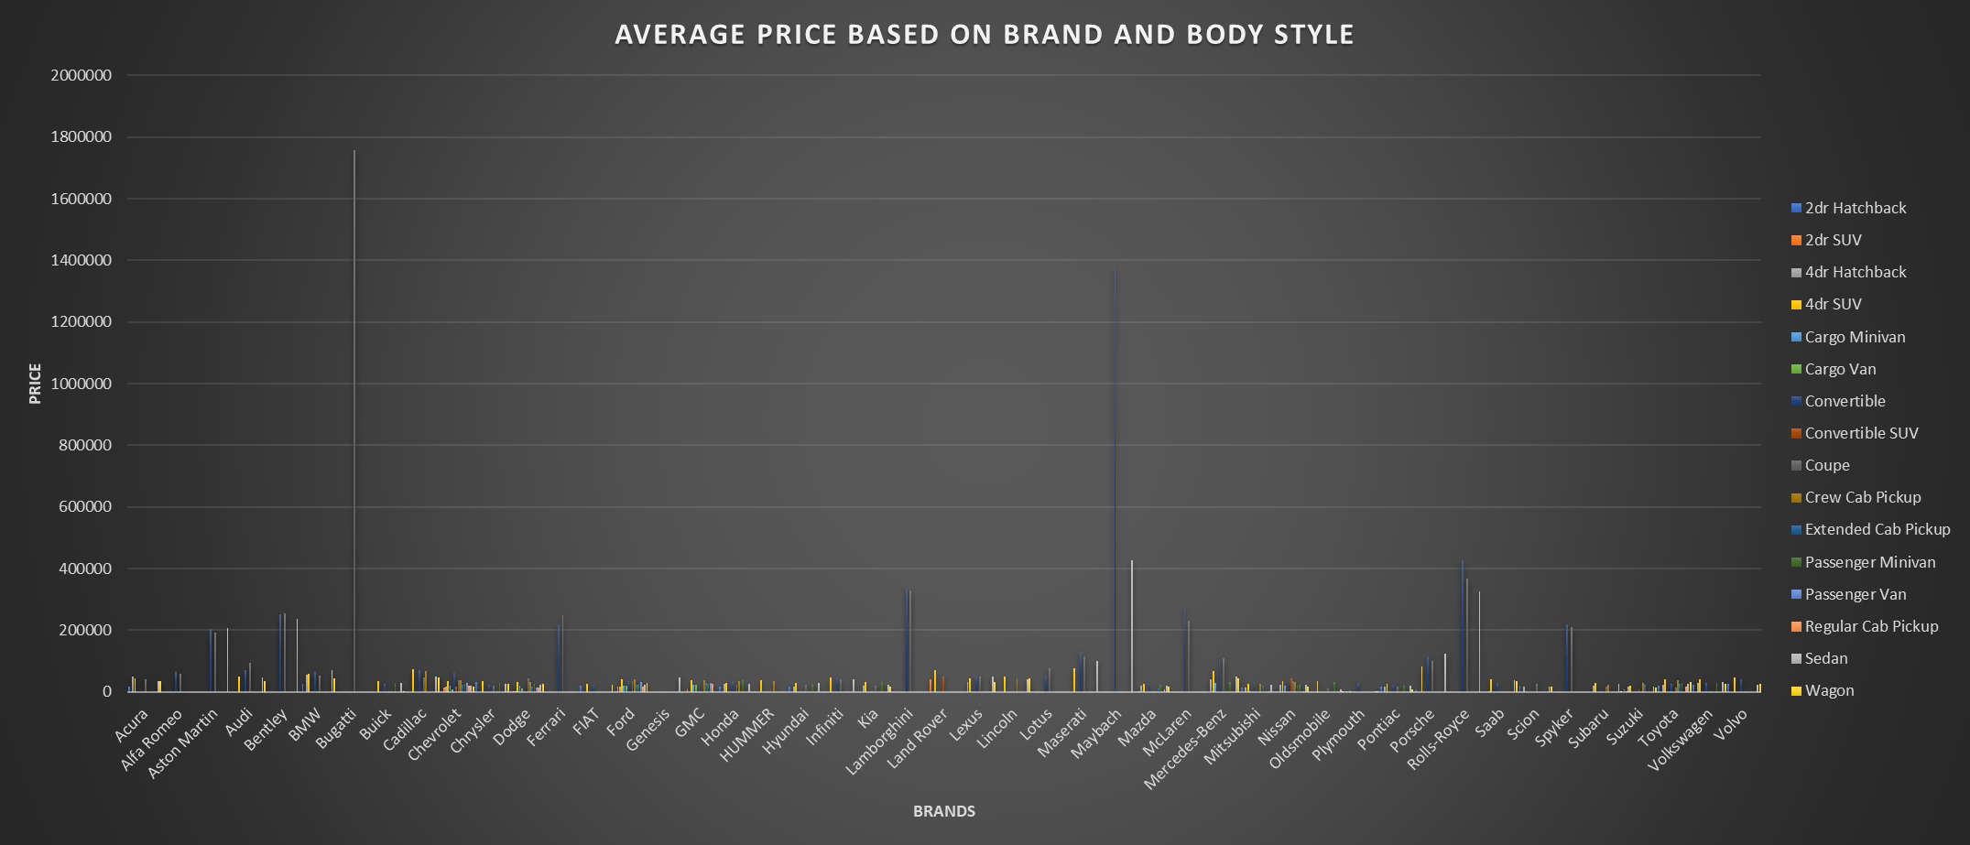
Task 2: Which car brands have the highest and lowest average MSRPs, and how does this vary by body style?
From the clustered chart, we can see that the couple style Bugatti and the Convertible style of Myabach have the highest average car prices.

Slide 13
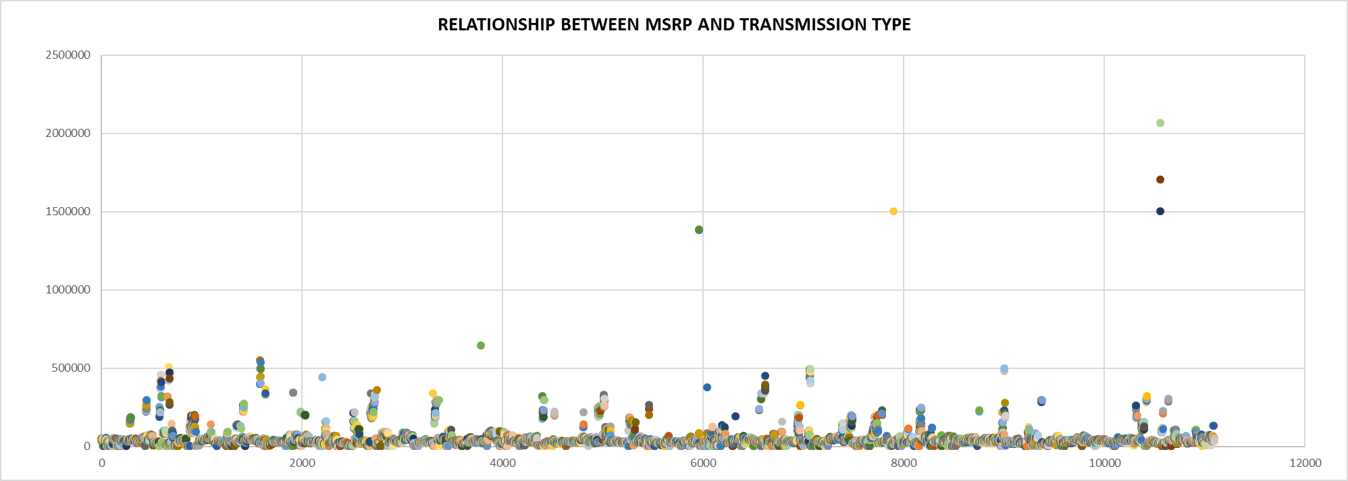
Task 3: How do the different feature such as transmission type affect the MSRP, and how does this vary by body style?
From the chart, we can see that the automated convertible and automated_manual couple are highly contributing in MSRP.

Slide 14
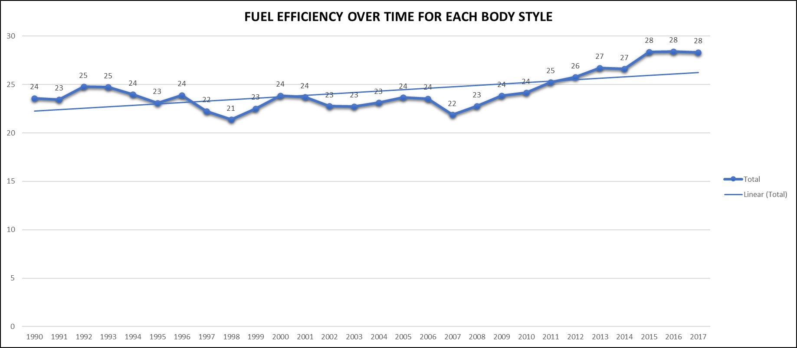
Task 4: How does the fuel efficiency of cars vary across different body styles and model years?
From the line chart, we can see that as time increases fuel efficiency (Highway MPG)also increased or improved.

Slide 15
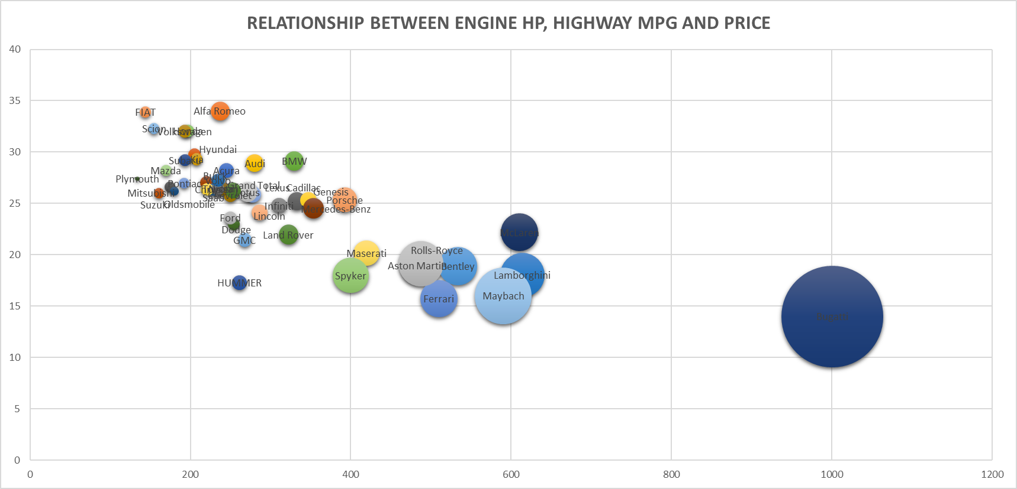
Task 5: How does the car's horsepower, MPG, and price vary across different Brands?
From the Bubble chart, we can see that if engine hp increase, highway mpg will decrease and the price will also increase.

Slide 17
RESULT
Coupe body style contributing maximum to the car’s MSRP.
In transmission type automated_manual creates high impact because in a single car having both automated and manual gear systems will be more beneficial rather than a single gear system.
Overall, fuel efficiency and Coupe body style features highly impact the car’s price and profitability.
Companies need to produce high or at least good fuel efficiency of cars by which the majority of the class can afford a car.
LINK OF EXCEL SHEET
https://docs.google.com/spreadsheets/d/1iM37wNlqXqpS4EirG4VBui-3lPx39Uiu/edit?usp=sharing&ouid=102517788337362241828&rtpof=true&sd=true

